Slide 1
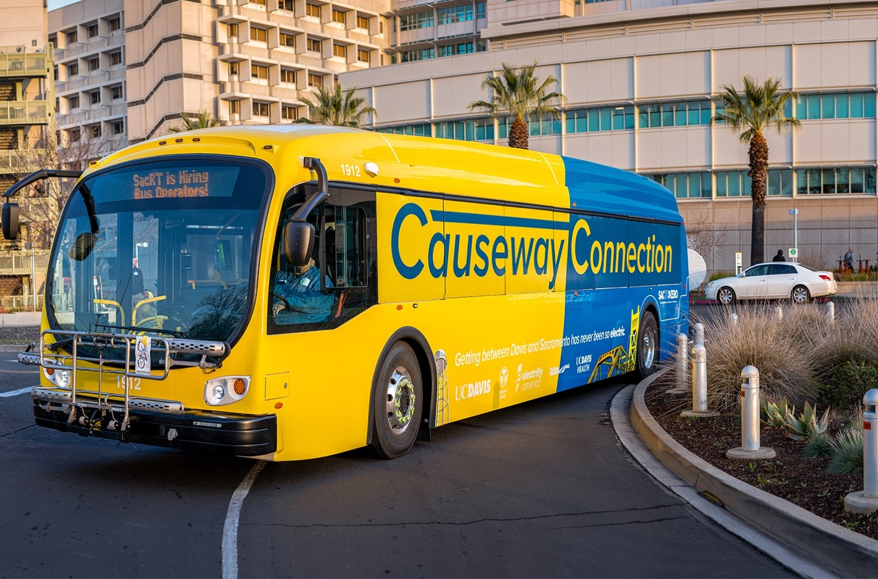
Zero Emission Vehicle
Transition Plan Phase II
Presentation to:
SACOG TCC
March 16, 2022

Slide 2
Background
California Air Resources Board (CARB) adopted Innovative Clean Transit (ICT) regulation in December 2018
Requires all transit agencies to transition to 100% zero emission fleet by 2040.
Zero Emission Bus Rollout was adopted by SacRT Board in October 2020, as required by CARB
Annual Reporting of fleet data to CARB began in 2021.
SacRT Phase I Zero Emission Vehicle Plan completed in 2020, included ICT Rollout Plan.

Slide 3
ZEV Planning Phase II
Plan is Organized in the Following Sections
This report is organized into five main sections:
Introduction – Provides the background on the project, SacRT’s previous ZEB studies, and the report’s purpose and structure.
Garage Concepts – Overview of the general background and approach taken to develop garage concepts and estimate power needs, and presents the site-specific design concepts, improvements, and considerations.
ZEB Transition – Presents the proposed construction schedule and procurement schedule.
Costs and Funding – Presents an opinion of probable costs associated with the transition.
Findings and Next Steps – Summarizes the findings of the report and identifies the next steps in the process of transitioning SacRT’s fleet to ZEBs.

Slide 4
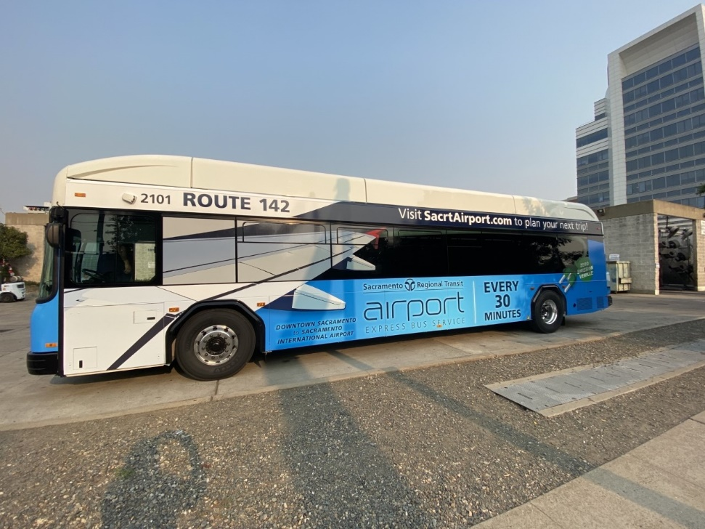
Facilities Planning
Propose three new purpose built Zero Emission Bus garages
North, South and East
Will consider both Battery
Electric Bus (BEB) and
Hydrogen Fuel Cell (FCEB)
Transition period will include temporary charging infrastructure

Slide 5
Facilities Planning
Facility | East Garage | North Garage | South Garage
Location | TBD | TBD | TBD
Function | Storage and Dispatch | Storage, Dispatch, O&M | Storage, Dispatch, O&M
ZEB Operations* | BEB-only | BEB and/or FCEB | BEB and/or FCEB
Minimum Fleet Vehicle Capacity | 35 | 100 | 300
Operational Specifications | Herringbone Parking | Herringbone Parking | Herringbone Parking

Slide 6
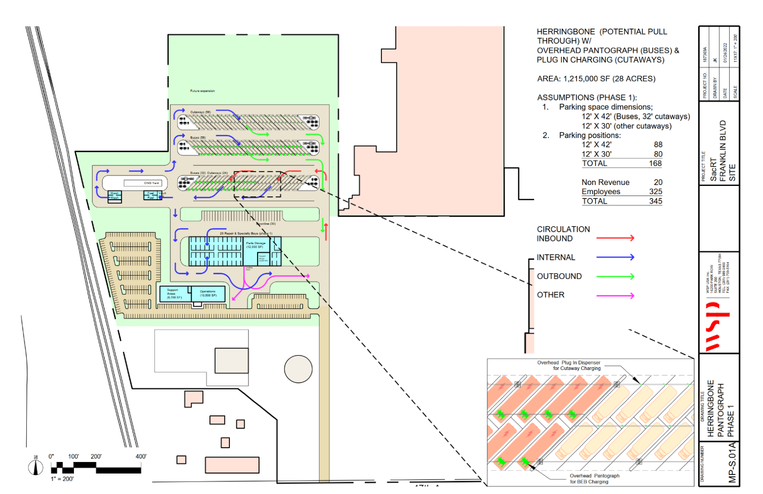
Garage Concepts

Slide 7
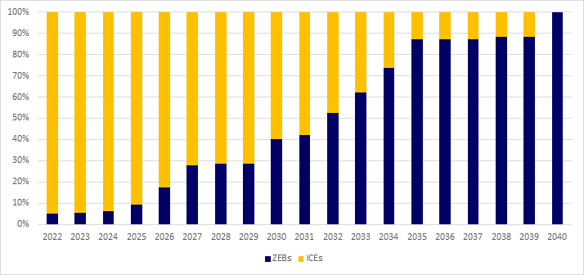
ZEV Transition Schedule

Slide 8
Cost Estimates
Vehicles
Facilities

Slide 9
Construction Schedule
Responsibility | Stage | Description | Duration (months)
SacRT | Land Acquisition | Identify and acquire land for the new garages. This would include environmental clearance and permitting. | 18
SMUD | Utility Enhancements | Plan, design, and construct off-site utility enhancements to support the power needs of each garage. | 36
SacRT | Design Procurement | Develop, advertise, and award contract to develop detailed designs for each garage. | 12
Designer | Detailed Design | Take conceptual designs to 100%. | 18
SacRT | Construction Procurement | Develop, advertise, and award contract to construct infrastructure at each garage. | 12
Contractor | Construction | Construction at each garage, including the structure, charging/fueling infrastructure, and supporting connections. | 24

Slide 10
Next Steps
Acquire sites and begin utility coordination and negotiations.
Refine conceptual drawings and/or develop 100% designs and a detailed Master Plan.
Plan service relocations and identify cost impacts.
If necessary, engage CARB to file for exemptions.

